Slide 1
Lecture Plan
Review
User Interface
Kernel
Interaction with Hardware
Interaction with Applications

Slide 2
Functions of an OS
Memory management
Processor management
Device management
Storage management
User interface

Slide 3
Memory Management
Allocation of memory based on program need
Real mode: first 1 MB of memory (16-bit)
Protected mode: up to 4 GB (32-bit)
  Supports multitasking and restricted memory access
  Windows XP and Linux operate in protected mode
Notes:
<number><number>

Slide 4
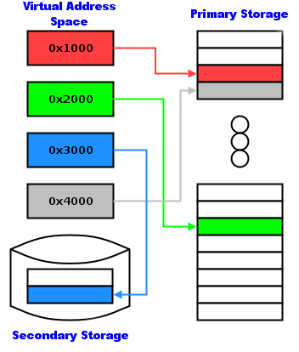
Virtual Memory
Virtual addresses map to real storage addresses
Paging occurs when a chunk of memory in secondary storage is swapped with a chunk of memory in primary storage.

Slide 5
Processor Management
Modern multitasking operating systems run multiple programs at once
Each program
consists of one or
more processes
Simultaneous
execution is actually rapid switching
Multiprocessing means the use of two or more CPUs in a single computer

Slide 6
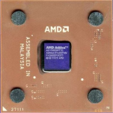
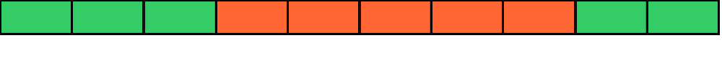
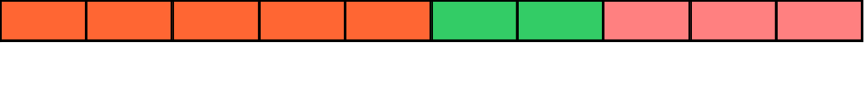
Context Switching
Interrupts are used control process execution
An interrupt causes the processor to save its state of execution via a context switch, and begin execution of an interrupt handler.
B. Context
switch – context
is saved to RAM
A. Interrupt
occurs
C. Execution of
interrupt handler
begins
RAM
Process
Interrupt Handler

Slide 7
Device Management
Device drivers connect the OS to hardware
A device driver typically:
  Implements an interface to the device
  Implements an interface to the operating system
  Sends commands and/or receives data to and from the device

Slide 8
Example: Printer Drivers
Windows XP
  Application provides graphical device interface (GDI)
  Driver connects GDI to a device, such as a printer
Linux
  Application produces PostScript (page description)
  Flow passes to device driver
  Ghostscript converts PostScript to device commands

Slide 9
Storage Management
Partition management
File systems
File maintenance
Security
Quota management

Slide 10
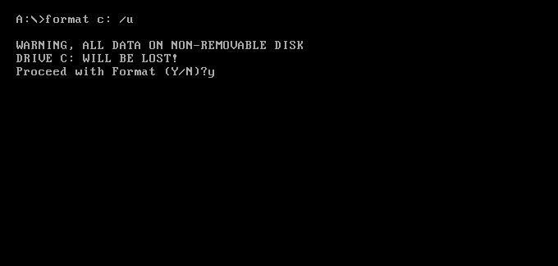
Storage Management
MS-DOS
  fdisk
  format
Windows XP
  Disk Management utility
  Windows Explorer
Linux
  fdisk
  mke2fs

Slide 11
User Interface
User interface has two functions:
  Input – allows the user to manipulate the system
  Output – allows the system to produce the effects of the user’s manipulation

Slide 12
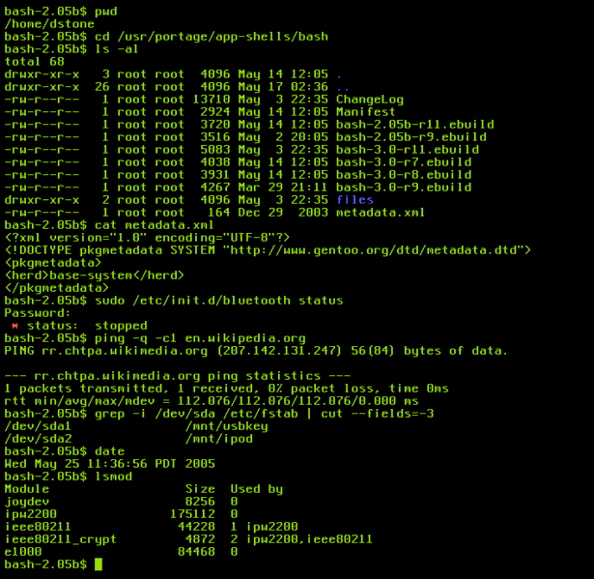
Command Line Interface
Most basic/powerful is the command-line interface (CLI)
  text-based interaction using only keyboard
  large vocabulary of commands
  wide range of options for commands
  often faster and more flexible than a GUI

Slide 13
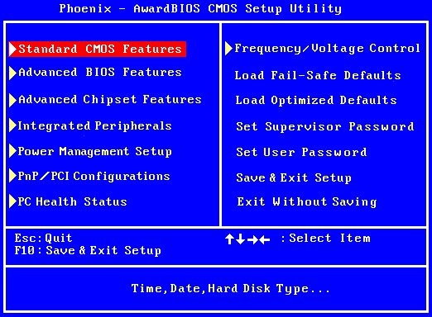
Text User Interface
Text User Interface (TUI)
  First layer of abstraction above the CLI
  User selects options and commands from list
  May support use of a mouse as well as a keyboard

Slide 14
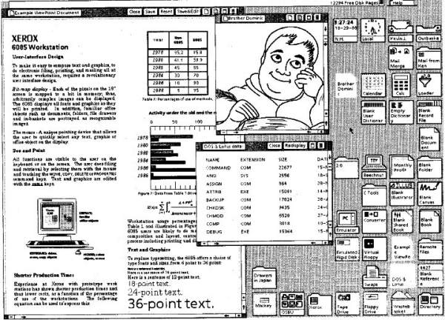
Graphical User Interface
Graphical user interface (GUI)
  “WIMP” – Windows, Icons, Menus and Pointing device
  Developed by Xerox in 1981
  Modern example: Windows XP desktop

Slide 15
Xerox Alto GUI

Slide 16
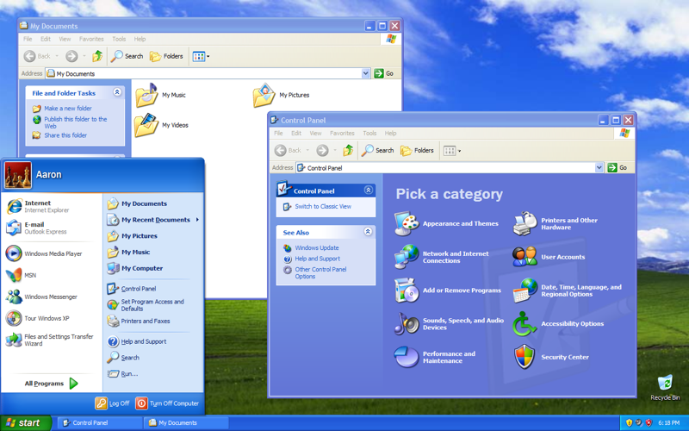
Windows XP GUI

Slide 17
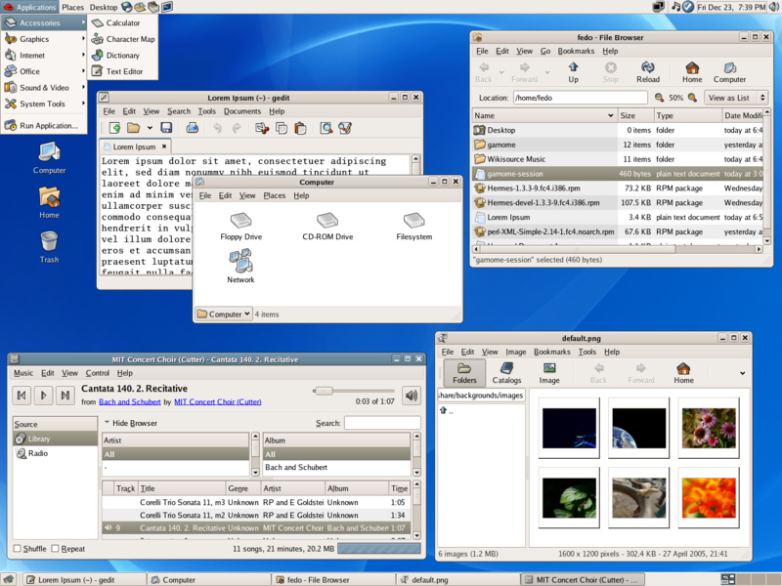
Linux: GNOME GUI

Slide 18
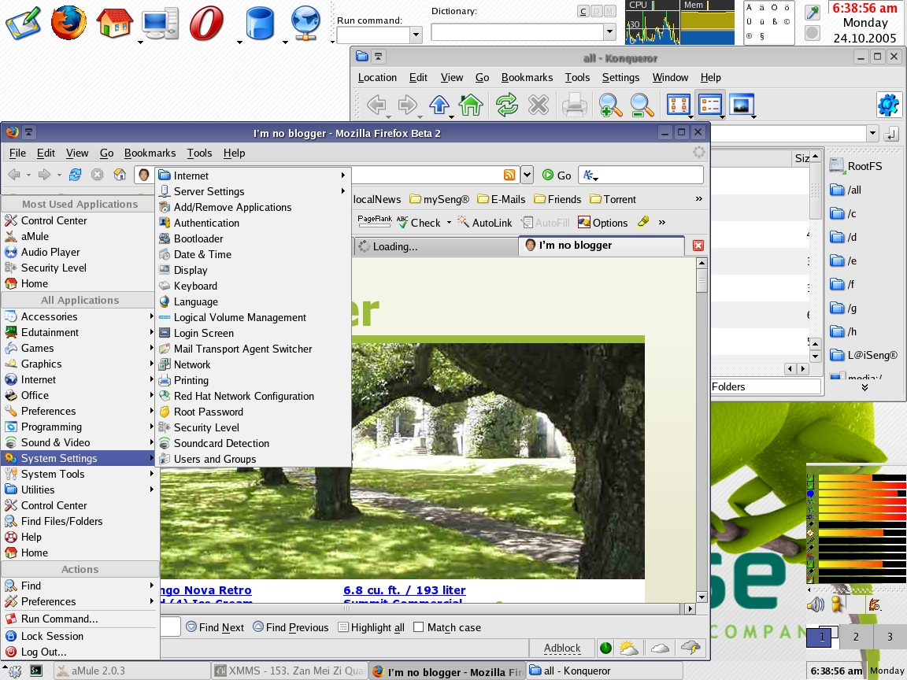
Linux: KDE GUI

Slide 19
Kernels
Kernel: the core of the operating system
  Interacts with hardware
  Ensures that applications are serviced
Broad categories: microkernel and monolithic kernel

Slide 20
Microkernel
Microkernel operates in two modes
  Kernel: provides core processing only
  User: provides services such as networking
Microkernels generally underperform
  Context switching can generate significant costs

Slide 21
Monolithic Kernel
Also divided into kernel and user modes
Processes executed in kernel mode
  Memory management
  The scheduler
  Device interfaces
Applications executed in user mode

Slide 22


Monolithic Kernel
Operating systems implementing monolithic kernels
  Linux, FreeBSD, Microsoft Windows XP
  Each OS loads additional modules at run time
  Most modules are device drivers, or provide network or file system services

Slide 23
Windows XP Kernel
Four basic types of user mode processes in XP
  System support processes: Winlogon, session manager
  Service processes: Task Scheduler, print spooler
  User applications: DOS, Windows 3.1, Win32
  Environment subsystem: emulates Win32 environment

Slide 24
Windows XP Kernel
Applications pass OS service requests through DLLs
DLL (Dynamic link library): set of functions or data
  Interface between user applications and OS

Slide 25
Windows XP Kernel
Kernel components of Windows XP
  Executive: provides basic OS services ie. memory management
  Kernel: provides low-level OS functions ie. process scheduling
  Device drivers: translates I/O requests to hardware I/O requests
  Hardware abstraction layer: insulates kernels/drivers
  Windowing and graphics: implements user interface ie. GUI

Slide 26
Linux Kernel
Five main subsystems
  Process scheduler (SCHED) - Controls access to the CPU
  Memory manager (MM) - Shares memory among processes

Slide 27
Linux Kernel
  Virtual File System (VFS)
  Network Interface (NET)
  Interprocess communication (IPC)

Slide 28
OS Interaction with Hardware
Windows XP
  Windows Driver Model (WDM)
  Implemented in all versions of Windows after ‘95
Linux
  Character devices
  Block devices
  Network devices

Slide 29
Windows Driver Model (WDM)
Specifies source-code compatible drivers
  Portions of driver code integrated into OS
  WDM driver becomes more streamlined
Three kinds of WDM drivers
  Bus (1)
  Function (4)
  Filter (2, 3, 5)

Slide 30
WDM Bus Drivers
Bus drivers drive an
I/O bus
WDM support is provided for a number of buses
  Examples: PCI, Plug and Play serial I/O, SCSI, USB

Slide 31
WDM Function Drivers
Function drivers drive an individual device
WDM support is provided for USB device classes
  Examples: cameras/scanners, USB storage devices

Slide 32
WDM Filter Drivers
Filter drivers filter I/O requests
Requesting objects: device, class of devices, bus
  Example: used by antivirus agent to intercept files

Slide 33
Linux Devices
Device files (also called special files)
  Character
  Block
  Networking

Slide 34
Linux Character Devices
Character devices
  Can be accessed as streams of characters
  Example: standard input device (keyboard)

Slide 35
Linux Block Devices
Block devices
  Handle I/0 operations by block (usually 512 bytes)
    Block may exceed 512 bytes by power of 2
  Examples: disk drives, CD drives, loop devices

Slide 36
Linux Networking Devices
Networking devices
  Handled differently than block or character devices
  Require kernel to manage packets

Slide 37
OS Interaction with Applications
Application support provided by OS
  Installing applications
  Running applications
  Managing disks and files
  Connecting to a network
  Printing documents
Notes:
<number><number>

Slide 38
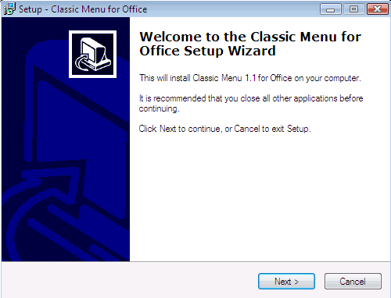
Installing Applications
Typical software installation steps
  Request made to OS to install application
  OS locates program files on media (ie. CD)
  OS copies program files to hard drive
  Program entry created on application menu
  Application configured for use
Notes:
<number><number>

Slide 39
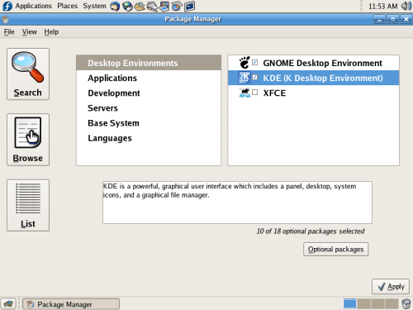
Installing Applications
Windows registry: maintains system configuration
  Accessed by application installers or Registry Editor
Microsoft Windows Installer used by Windows XP
Advanced Packaging Tool (APT) used by Ubuntu

Slide 40
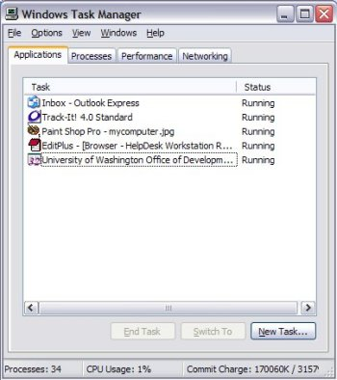
Running Applications
OS tasks triggered by request to run an application
  User’s authorization level is checked
  Address space for the program is allocated
  Program is loaded into the address space
  Processes are scheduled for execution
  Execution of processes is monitored
Notes:
<number><number>

Slide 41
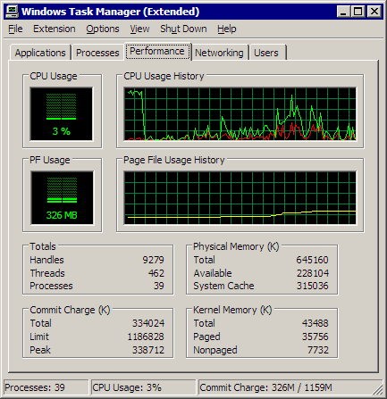
Running Applications
OS tasks performed during program execution
  Process assigned to processor according to schedule
  I/O operations queued for execution
  Data read from or written to requested device
  Program terminated and memory released on request
Notes:
<number><number>

Slide 42
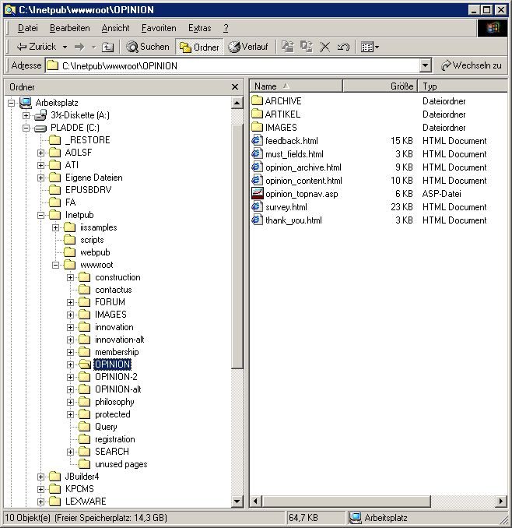
Managing Disks and Files
Data files arranged in system specific hierarchy
  Windows XP implements a folder structure
  Linux uses a directory structure similar to XP folders
Notes:
<number><number>

Slide 43
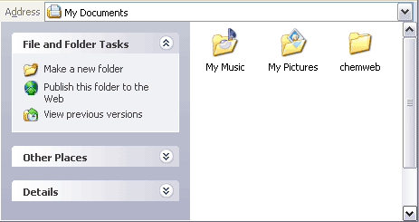
Managing Disks and Files
Basic features of folder structure in Windows XP
  View folder structure and file attributes with Explorer
  Home folder is called My Documents
    Subfolder located under Documents and Settings

Slide 44
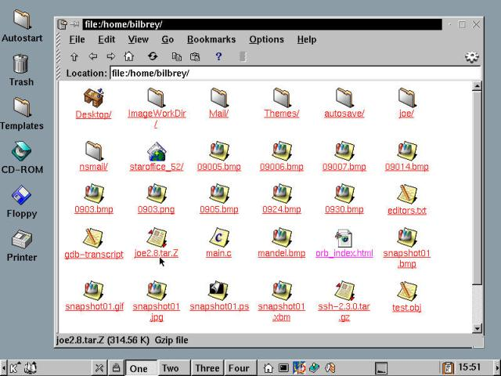
Managing Disks and Files
Basic features of directory structure in Linux
  View directory structure and file names with ls and tree
  Use the /home directory to store data
    Each user has a subdirectory inside this directory

Slide 45
Connecting to a Network
OS supports sharing of resources; e.g., files, printers
File server: central repository used for file sharing
Directories or folders may be shared on network
  Grant access to desired users only
Notes:
<number><number>

Slide 46
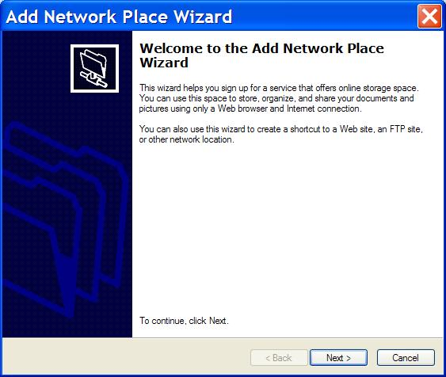
Connecting to a Network
Protocols used to support file sharing over network
  Server Message Block (SMB): used by Windows
  Samba: used by Linux
Tools used to access files over network
  Windows XP: Add Network Place Wizard
  Fedora Core 4: mount command

Slide 47
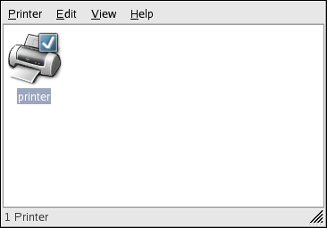
Printing Documents
Printed page: primary output for most documents
OS provides access to local and network printers

Slide 48
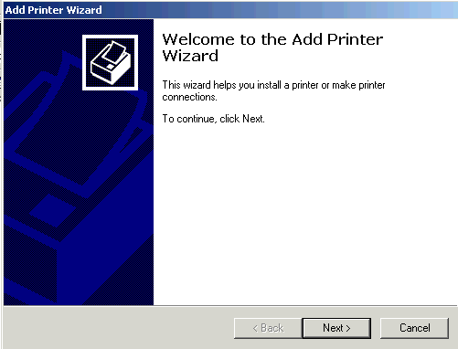
Printing Documents
Making printer available to application
  Windows XP: use the Add Printer Wizard
  Linux: use system-config-printer program
Using printer after installation and configuration
  Follow instructions provided by application

